Slide 1
QA&QC DURING THE SOFTWARE DEVELOPMENT LIFE CYCLE
Roxana Soporan
Andra Banto
April 22, 2024

Slide 2
Agenda
01
02
03
04
05
06
07
08
09
10
11
12
Introduction
QA & QC and Testing
Continuous Improvement (CI)
SDLC, STLC
Test Planning, Design, Execution & Reporting
Test Levels and Test Types
Agile using Scrum
Stories
Tasks
Test Suites and Test Cases
Bugs and everything in between
Life in a company, post pandemic and current situation

Slide 3
Become acquainted with us. Who we are, our purpose

Slide 4

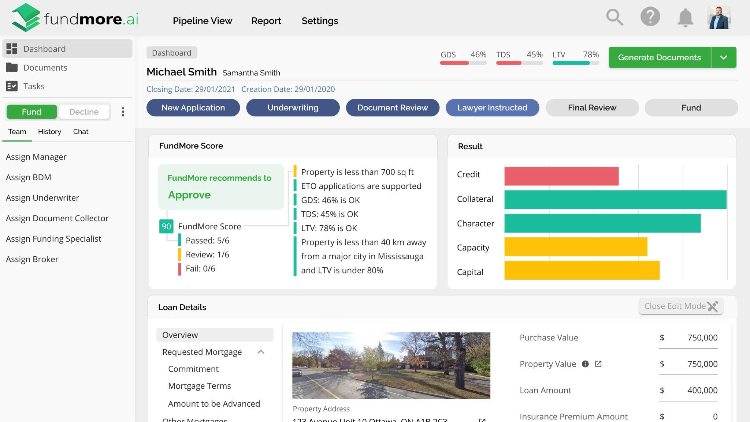

FundMore AI
LOS
Enhanced underwriting with instant decisioning
Notes:
Loan origination system.

Slide 5
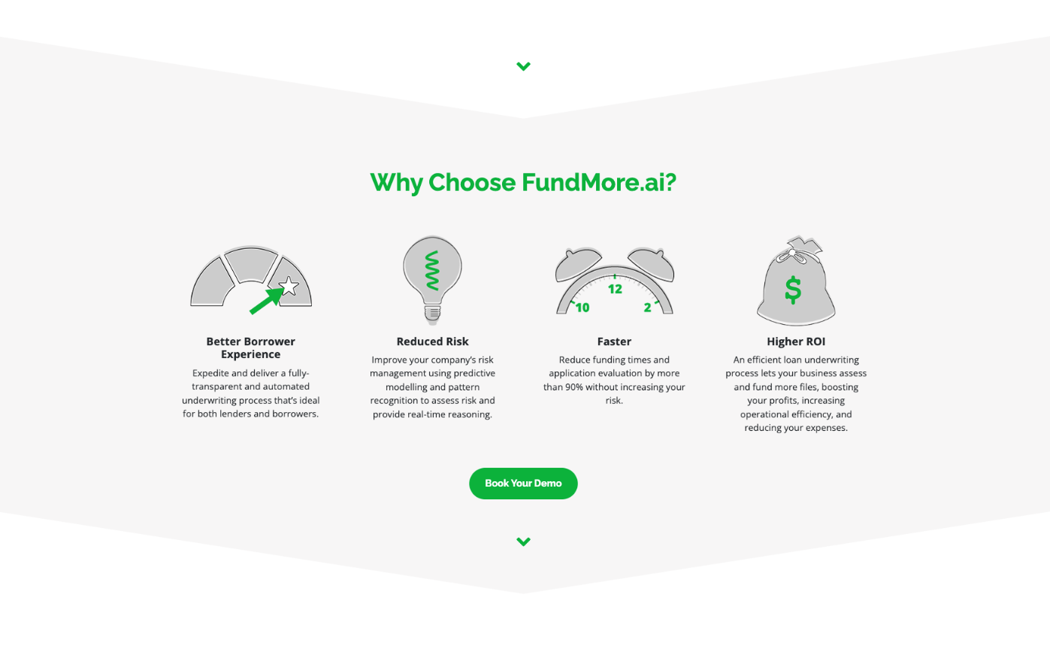


Slide 6
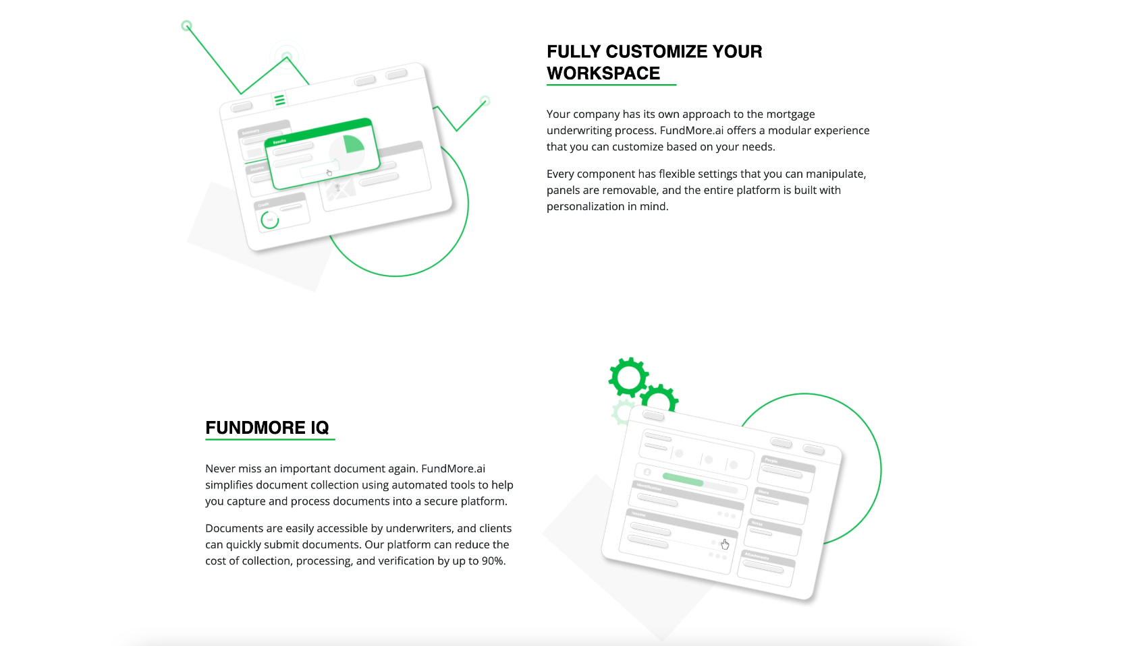

Slide 7
$5.3T
Total Available Market
Funded mortgage volume in North America
$113B
Service Obtainable Market
25% of mortgage volume funded in Canada
$392B
Service Accessible Market
* Residential mortgage volume in $CDN
Funded mortgage volume by Canadian Lenders

Slide 8
Quality assurance and Quality control:
what is the difference?
Notes:
The difference is that QA is process oriented and QC is product oriented.
Quality Assurance makes sure you are doing the right things, the right way.
Quality Control makes sure the results of what you've done are what you expected.

Slide 9
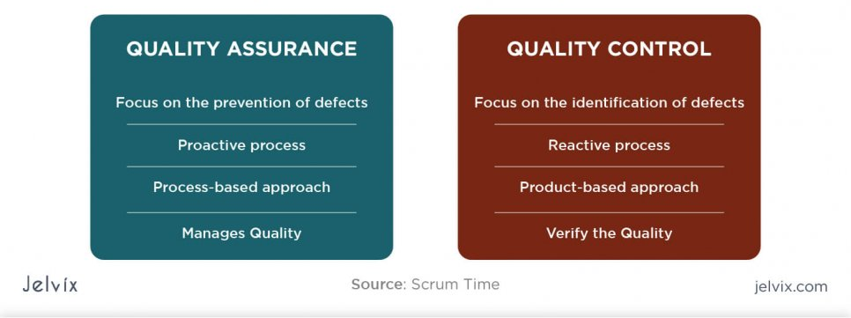
QA & QC
Notes:
The quality assurance and control have to be looked at as a whole.
Taken individually the 2 large components bring a lot lesser value to the overall quality of the product as they bring as taken together.
Although they and and verify different things.
How do you assure the quality of the work you are going to do?
Goal: Ensure adherence to processes, standards and plans
Focus: product development process
Activities: guide and monitor processes, ensure tests were done
How do you control the quality of the work you have done?
Goal: detect problems in the work products
Focus: product requirements
Activities: develop and run tests, check results

Slide 10
Measuring Quality
If you cannot define it
you cannot achieve it
If you cannot measure it
You do not know how you are progressing
You do not know when you have arrived
You cannot demonstrate it
Notes:
If you don’t know where you are, a map won’t help ☺
Conclusion:
You’ll need to agree on:
A definition of quality
The metrics you will use
The process to evaluate quality before launching every new release

Slide 11
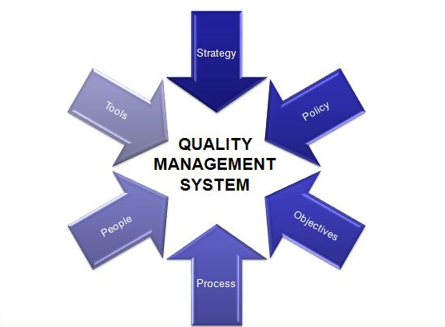
Quality Management System (QMS)
Notes:
A quality management system (QMS) is a set of policies, processes and procedures required for planning and execution (production/development/service) in the core business area of an organization
Improving processes
Reducing waste
Lowering costs
Facilitating and identifying training opportunities
Engaging staff
Setting organization-wide direction
Major components:
1. Verification and validation
1.1 Verification – internal – evaluation that a product/service is compliant with specifications , requirements or imposed conditions
1.2 Validation – external – the assurance that the delivered product meets the needs of client.
2. Organizational policy – in a company, a document which protects the project teams from being rushed/cutting corners/doing a poor quality job
3. Quality objectives. Ex: Defect detection percentage / Quality attributes (Non-functional) / Estimation deviations (predictability), etc.
It is not somebody else’s job – everybody(from managers to project teams) is involved in delivering quality

Slide 12
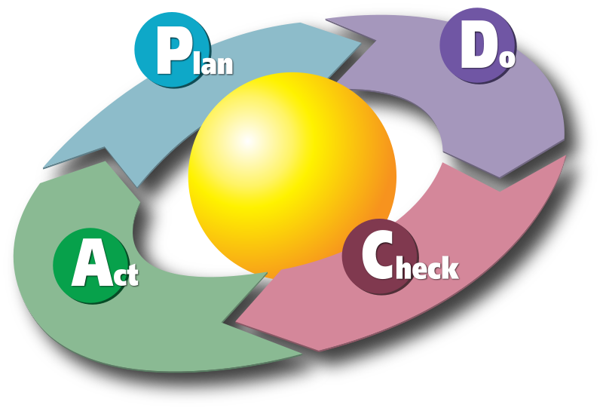
Continuous Improvement
Notes:
Continuous improvement - is an ongoing effort to improve products, services, or processes. These efforts can seek "incremental" improvement over time or "breakthrough" improvement all at once.
In other words means “getting better all the time”
What is the benefit of CI?
- More streamlined work. – Best practices , lessons learned
- Reduced time ,rework , and cost

Slide 13
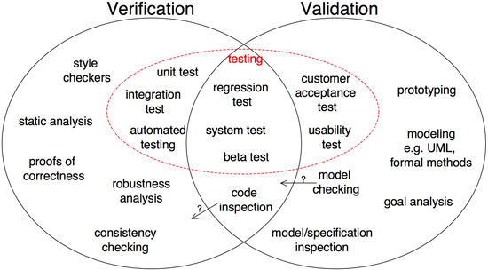
Verification & Validation
Notes:
VERIFICATION checks that the system was built right
VALIDATION checks that the right system was build
Verification is testing that your product meets the specifications / requirements you have written. "Did I build what I said I would?".
Validation tests how well you addressed the business needs that caused you to write those requirements. It is also sometimes called acceptance or business testing. "Did I build what I need?"
V&V together make sure that your software has delivered on its purpose in an error-free (ideally) way.
In an Agile development process, ideally both verification and validation activities occur as close to simultaneously as possible. This is because you are always updating and refining your User Stories, necessitating constant small V&V loops to enable this continual feedback.

Slide 14

Why is software testing necessary?
“On 4 June 1996 the maiden flight of the Ariane 5 launcher ended in a failure. Only about 40 seconds after initiation of the flight sequence, at an altitude of about 3700 m, the launcher veered off its flight path, broke up and exploded.”
(https://www.esa.int)
Notes:
Ariane 5
- The Ariane 5 rocket launch took place on Tuesday, 4 June 1996.
- It ended in failure due to an error in the software design
- This resulted in the rocket veering off its flight path
- self-destructed after – 37 seconds
- The failure resulted in a loss of more than US $370 million.

Slide 15
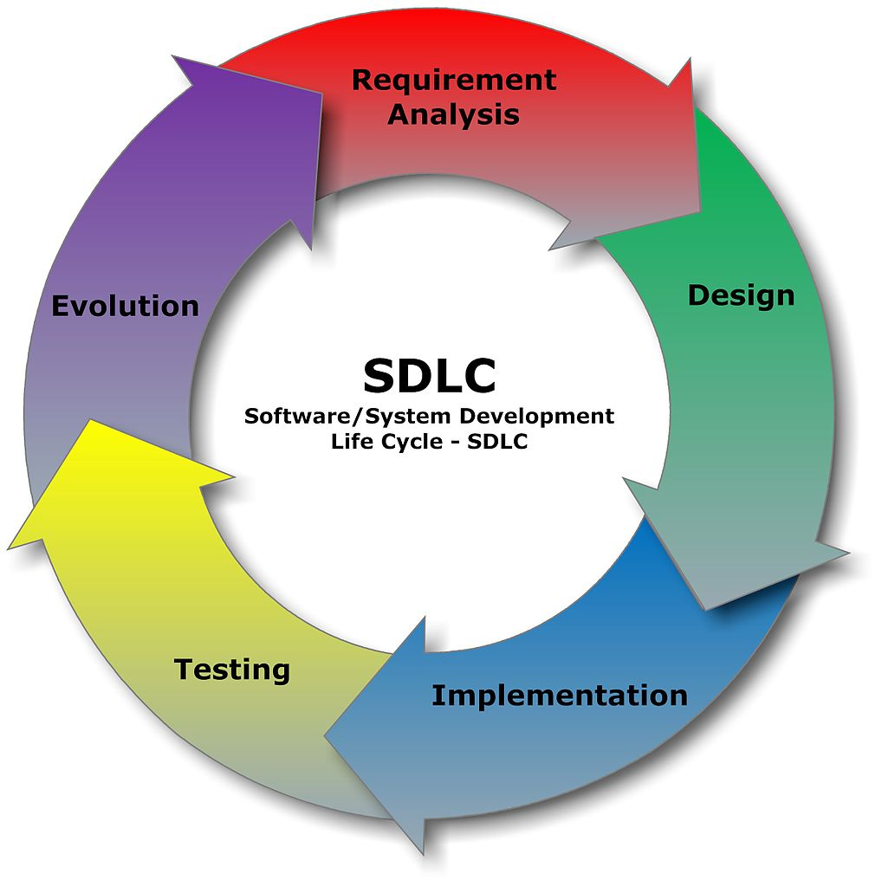
Notes:
The Software Development Life Cycle (SDLC) refers to a methodology with clearly defined processes for creating high-quality software
SDLC or the Software Development Life Cycle is a process that produces software with the highest quality and lowest cost in the shortest time possible. SDLC provides a well-structured flow of phases that help an organization to quickly produce high-quality software which is well-tested and ready for production use.
https://stackify.com/what-is-sdlc/

Slide 16
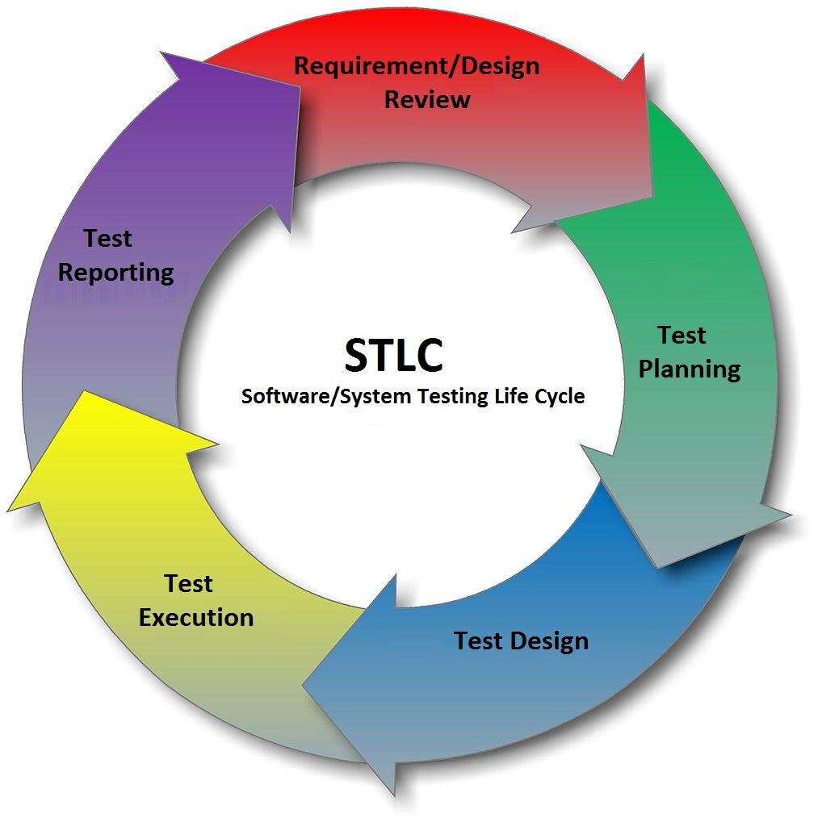
Notes:
Software Testing Life Cycle (STLC) is a sequence of specific activities conducted during the testing process to ensure software quality goals are met. Contrary to popular belief, Software Testing is not just a single/isolate activity, i.e. testing. It consists of a series of activities carried out methodologically to help certify your software product.
https://www.guru99.com/software-testing-life-cycle.html

Slide 17
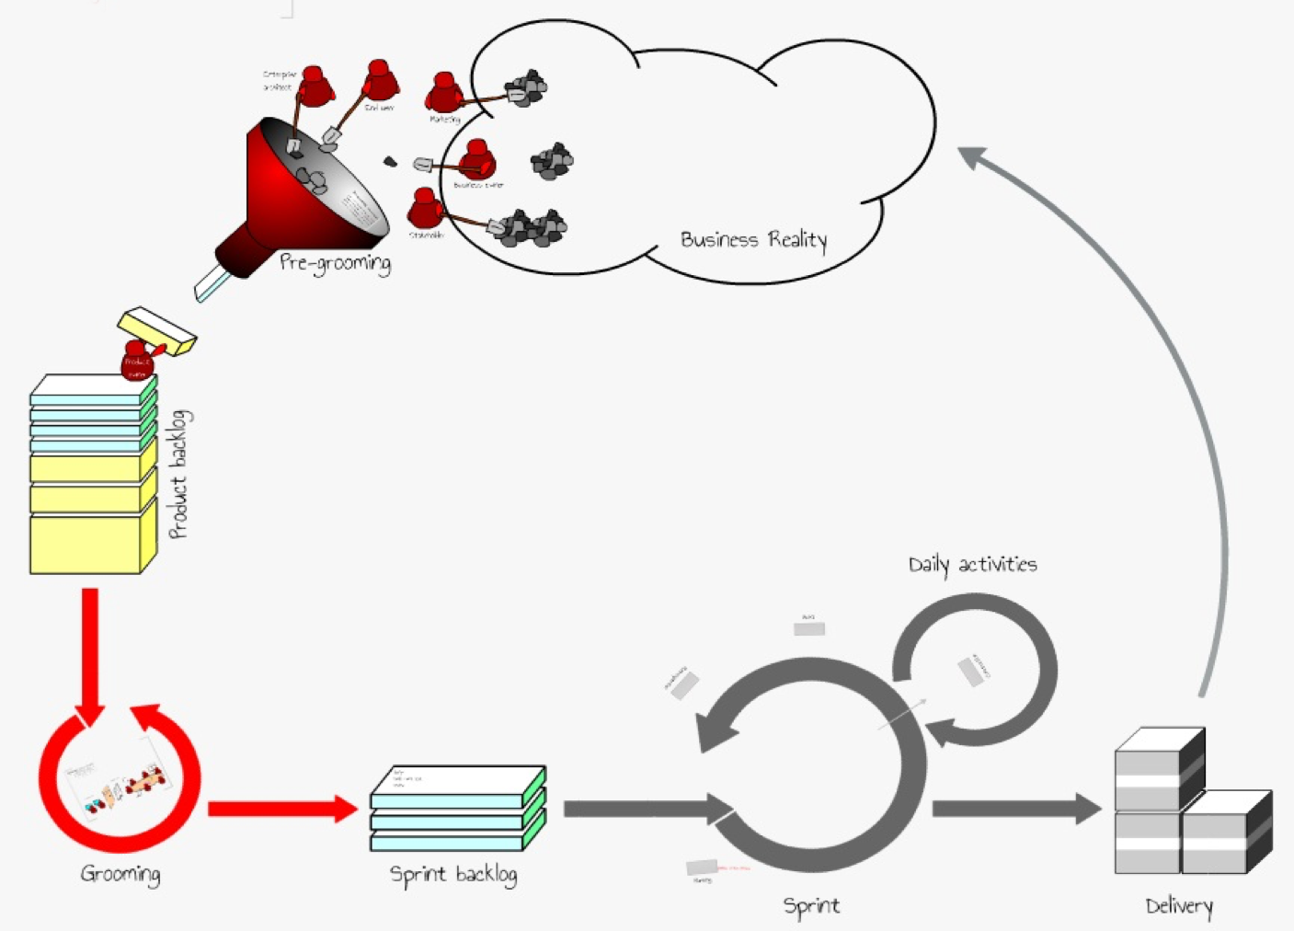
Notes:
Agile workflow is an iterative method of delivering a project. In Agile, multiple individual teams work on particular tasks for a certain duration of time termed as ‘Sprints’. “AgileWorkflow can be defined as the set of stages involved in developing an application, from ideation to sprints completion”.
Scrum is an agile workflow process based on a repetitive approach. Scrum emphasizes continual improvement for customer satisfaction. The workflow of Scrum consists of ‘Product Backlog’, ‘Planning Sprint’, ‘Sprint Backlog’, ‘Sprint’, ‘Routine Scrum Meetings’, ‘Sprint Reviewal’ and ‘Internal Scrum Meetings’.
OPTIONAL: Kanban is based on the lean development process, which is a popular methodology introduced by Toyota Motors. It is an agile method that is non-iterative and is less structured. It emphasizes on delivering quality on a continual basis by effective team collaboration. The Kanban workflow comprises of ‘Product Backlog’, ‘Requirements’, ‘Design’, ‘Development’, ‘Testing’, ‘Deployment’, and ‘Done’ stages.

Slide 18
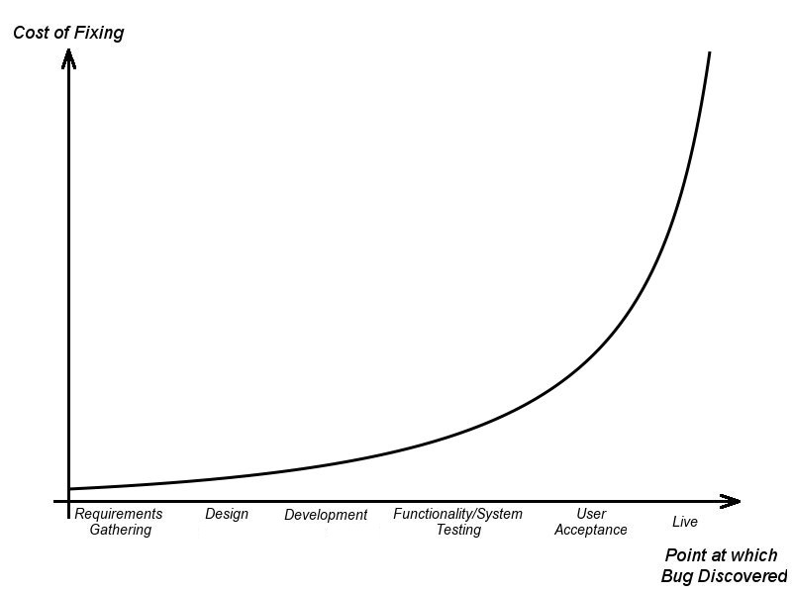
Notes:
if a bug is found in the requirements-gathering phase, the cost could be $100. If the product owner doesn’t find that bug until the QA testing phase, then the cost could be $1,500. If it’s not found until production, the cost could be $10,000. And if the bug is never found, it could be secretly costing the company money and no one could be the wiser. A 2003 study commissioned by the Department of Commerce’s National Institute of Standards and Technology found that software bugs cost the US economy $59.5 billion annually.

Slide 19
Why is software testing important?
“On 4 June 1996 the maiden flight of the Ariane 5 launcher ended in a failure. Only about 40 seconds after initiation of the flight sequence, at an altitude of about 3700 m, the launcher veered off its flight path, broke up and exploded.”
(https://www.esa.int)
Notes:
Remember the question?
To conclude, the importance of software testing is imperative. Software testing is a crucial component of software product development because it improves consistency and performance. The main benefit of testing is the identification and subsequent removal of the errors. However, testing also helps developers and testers to compare actual and expected results in order to improve quality. If the software production happens without testing it, it could be useless or sometimes dangerous for customers. So, a tester should wear a unique hat that protects the reliability of the software and makes it safe to use in real-life scenarios.

Slide 20
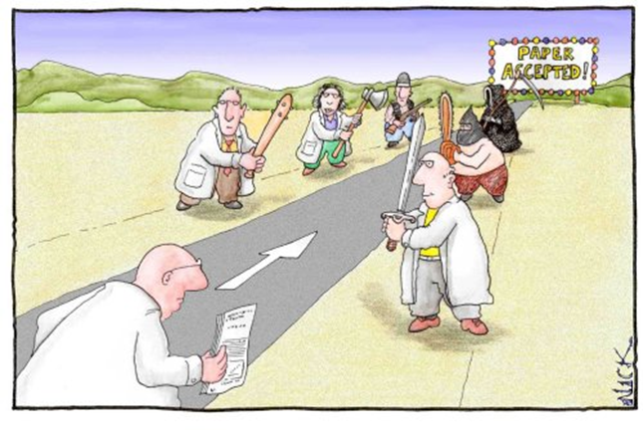
Notes:
Software Testers are not the Bad guys that aim to mess everything that the developers do. When kicking off a new software development project, naturally we all intend for it to be a success. But in order to be one you have to rely on a strong core — your software development team. While it is an undeniable truth that all teams are different in terms of their work style and the unique ecosystem within, there are some pretty common elements to it. We all expect our team to consist of highly experienced and skilled individuals. There are multiple processes and activities that a team can do in order to make sure that the software has the desired level of Quality. From which:
Code review is systematic examination (often as peer review) of computer source code.
Pair programming is a type of code review where two persons develop code together at the same workstation.
Inspection is a very formal type of peer review where the reviewers are following a well-defined process to find defects.
Walkthrough is a form of peer review where the author leads members of the development team and other interested parties through a software product and the participants ask questions and make comments about defects.
Technical review is a form of peer review in which a team of qualified personnel examines the suitability of the software product for its intended use and identifies discrepancies from specifications and standards.

Slide 21
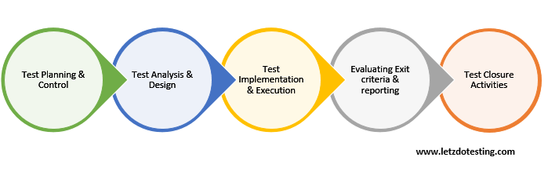
The fundamentals of test process
Notes:
The idea of a fundamental test process for all levels of test has developed over the years out of necessity, for better organization.
These activities are logically sequential, but, in a particular project, may overlap, take place concurrently and even be repeated.

Slide 22
Test Planning and Control
Test Planning:
Activities:
Determine the scope and risks and identify the objectives of testing
Determine the test approach (techniques, test items, coverage, identifying the testing team, resources)
Schedule test analysis and design tasks, test implementation, execution and evaluation
Determine exit criteria
Deliverables: Test Policy, Test Strategy, Test Plan
Test Control:
Activities:
Compare actual progress against the planned progress
Monitor and document progress, test coverage and exit criteria and provide information on testing through reports
Initiate corrective actions, if necessary
Deliverables: reports, test data
Notes:
Test policy is a document described at the organization level and gives the organizational insight for the test activities.
Test strategy document is prepared at the program level and includes general test strategy, management principles, processes and approaches for the tests to be performed for a software in detail.
Test plan is a document prepared at the project level.

Slide 23
Test Analysis and Design
The phase where general testing objectives are transformed into tangible test conditions and test designs.
Activities:
Review the test basis examining the specification for the software that we are testing
Identify test conditions
Design the high-level tests
Evaluate testability of the requirements and the system
Design the test environment setup and identify any required infrastructure and tools
Deliverables: test conditions, test suites

Slide 24
Test Implementation and Execution
Test Implementation:
Activities:
Develop and prioritize our test-suites
Create scenarios and test-cases derived for efficient test execution
Implement / configure and verify the test environment
Deliverables: test data, test cases, test scripts.
Test Execution:
Activities:
Execute the test-suites and test-cases
Compare actual result with expected results
Log the outcome of the test execution, report discrepancies (bugs, defects, error reports)
Re-execute the tests that previously failed in order to confirm the fixes
Deliverables: test-execution reports, issues, issue-reports

Slide 25
Evaluating Exit Criteria and Reporting
Evaluating exit criteria is the activity where test execution is assessed against the defined objectives.
Activities:
Check the test logs against the exit criteria specified in test planning phase
Assess if more tests are needed or if the exit criteria specified should be changed
Write a test summary report for stakeholders
Deliverables: Test Summary Report, other reports

Slide 26
Test Closure activities
Closing the corresponding testing activities.
Activities:
Check which planned deliverables are actually delivered and to ensure that all incident reports have been resolved
Finalize and archive testware such as scripts, test environments, etc. for later reuse
Handover the testware to the maintenance organization. They will give support to the software and make any bug fixes or maintenance changes.
Evaluate how the testing went and learn lessons for future releases and projects
Deliverables: testware, archives with testware; process improvement suggestions

Slide 27
Test Levels
4
User Acceptance Testing
By End User/Customer
1
Unit Testing
By Developer
2
Integration Testing
By Developer & Tester
3
System Testing
By Tester
Notes:
Unit testing - done by the developers to make sure that their code is working fine and meet the user specifications. They test their piece of code which they have written like: classes, functions, interfaces and procedures.
Integration testing - done when two modules are integrated, in order to test the behavior and functionality of both the modules after integration.
System testing – here we test the compatibility of the application with the system. The purpose is to evaluate the system’s compliance with the specified requirements.
Acceptance testing: done to ensure that the requirements of the specification are met. This level has two phases:
1. Alpha testing: done at the developers` site at the end of the development process.
2. Beta testing: done at the customers site by the end users, just before the launch of the product.

Slide 28
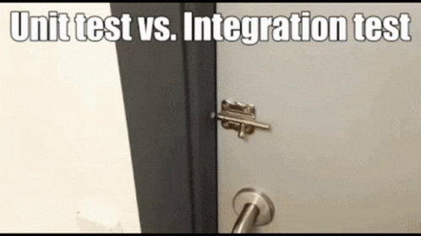

Slide 29


Slide 30
Test Types
Test Types
Functional Testing
Non-Functional Testing
Structural Testing
Change Related Testing
Retesting or Confirmation Testing
Regression Testing
Notes:
Functional -> WHAT the system does, testing can be done focusing on suitability, interoperability, security, accuracy and compliance. Security testing, for example, investigates the functions (e.g. a firewall) relating to detection of threats, such as viruses, from malicious outsiders.
Non functional – HOW WELL the system does it, testing can be done focusing on the quality characteristics of the system. We are testing something that we need to measure on a scale of measurement, for example time to respond. Non-functional testing includes, but is not limited to, performance testing, load testing, stress testing, usability testing, maintainability testing, reliability testing and portability testing.
Structural testing - often referred to as 'white-box' or 'glass-box' because we are interested in what is happening 'inside the box‘ aka in the code. In structural testing the testers are required to have the knowledge of the internal implementations of the code. Here the testers require knowledge of how the software is implemented, how it works. For example, a structural technique wants to know how loops in the software are working. Different test cases may be derived to exercise the loop once, twice, and many times. This may be done regardless of the functionality of the software.
Related to change testing -> if you have made a change to the software, you will have changed the way it functions, the way it performs or its structure so you need to do:
1. Confirmation testing (re-testing) -> When a test fails and we determine that the cause of the failure is a software defect, the defect is reported, and we can expect a new version of the software that has had the defect fixed. In this case we will need to execute the test again to confirm that the defect has indeed been fixed.
2. Regression testing -> involves executing test cases that have been executed before. The difference is that, for regression testing, the test cases probably passed the last time they were executed and now they can fail because of newly introduced bugs in the software after a fix or a change in the system.

Slide 31

Questions?

Slide 32
Agile Software Development using SCRUM
The SCRUM methodology is a framework within which people can address complex adaptive problems, while productively and creatively delivering products of the highest possible value.
In other words Scrum is a lightweight framework that helps people, teams and organizations generate value through adaptive solutions for complex problems.
Notes:
Scrum is a management framework that teams use to self-organize and work towards a common goal. It describes a set of meetings, tools, and roles for efficient project delivery.

Slide 33
Agile Software Development using SCRUM
A SCRUM Team is usually formed by 5 to 9 members working together to deliver the required product increments.
In Scrum, there are three roles: Product Owner, Development Team, and Scrum Master. Together these are known as the Scrum Team.
The common roles in our company within a SCRUM Team are:
Product Owner – “translates” the customer needs to the whole team; refines the Project Backlog (what to do)
Team Lead – ensures that the process runs smoothly, removes impediments, organizes critical events and meetings (how to do things)
Developer – writes the code for the project
Tester – tests the code
Designer – creates user-centered designs that meet the needs of end-users
Notes:
Scrum, SAFe
Kanban, waterfall

Slide 34
Agile Software Development using SCRUM
The most common AGILE Project Management tool that is designed to support any AGILE methodology, be it Scrum, Kanban, or something else is Jira Software.
From sprint boards to reports, the team can plan, track, and manage all their software development projects within a single tool.
But there are others: Youtrack, Rally, Azure, Helix, Trello, Github.

Slide 35
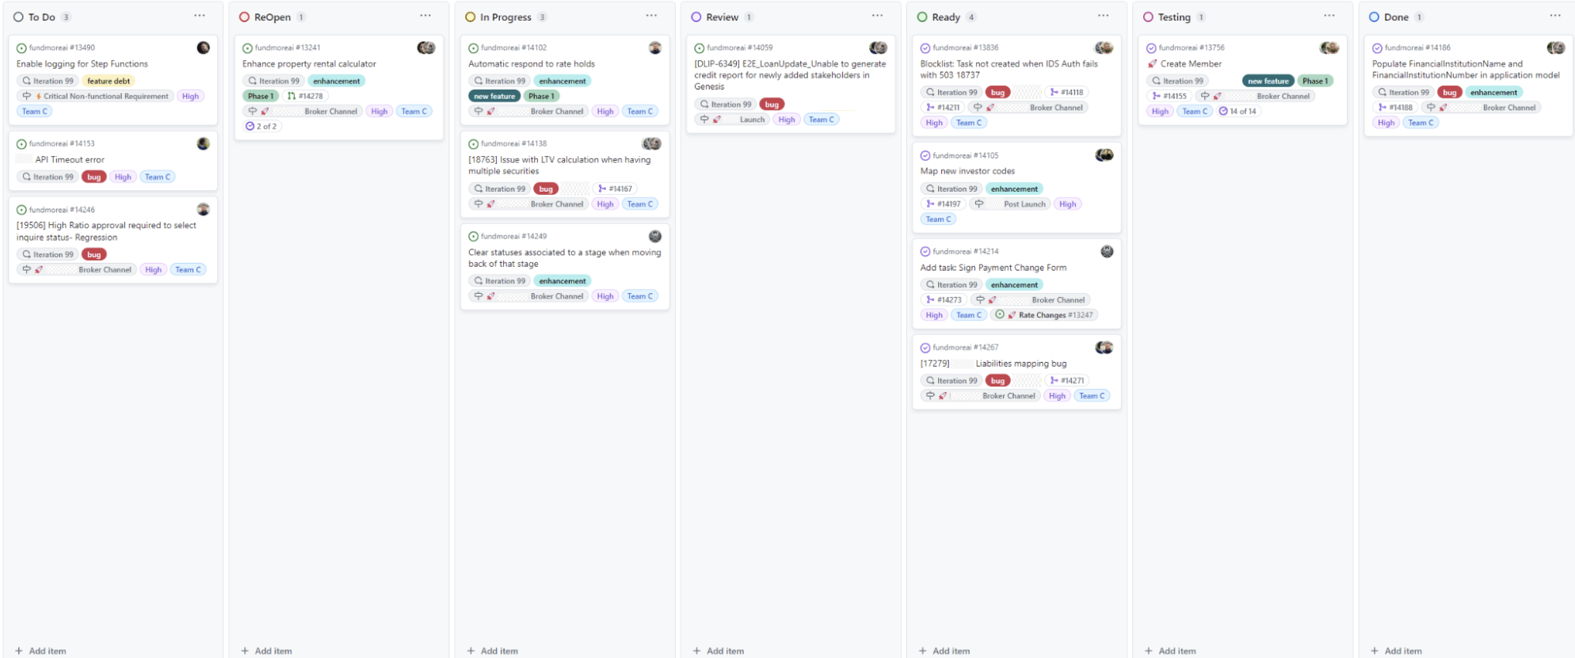
What does a SPRINT BOARD look like in Github?

Slide 36
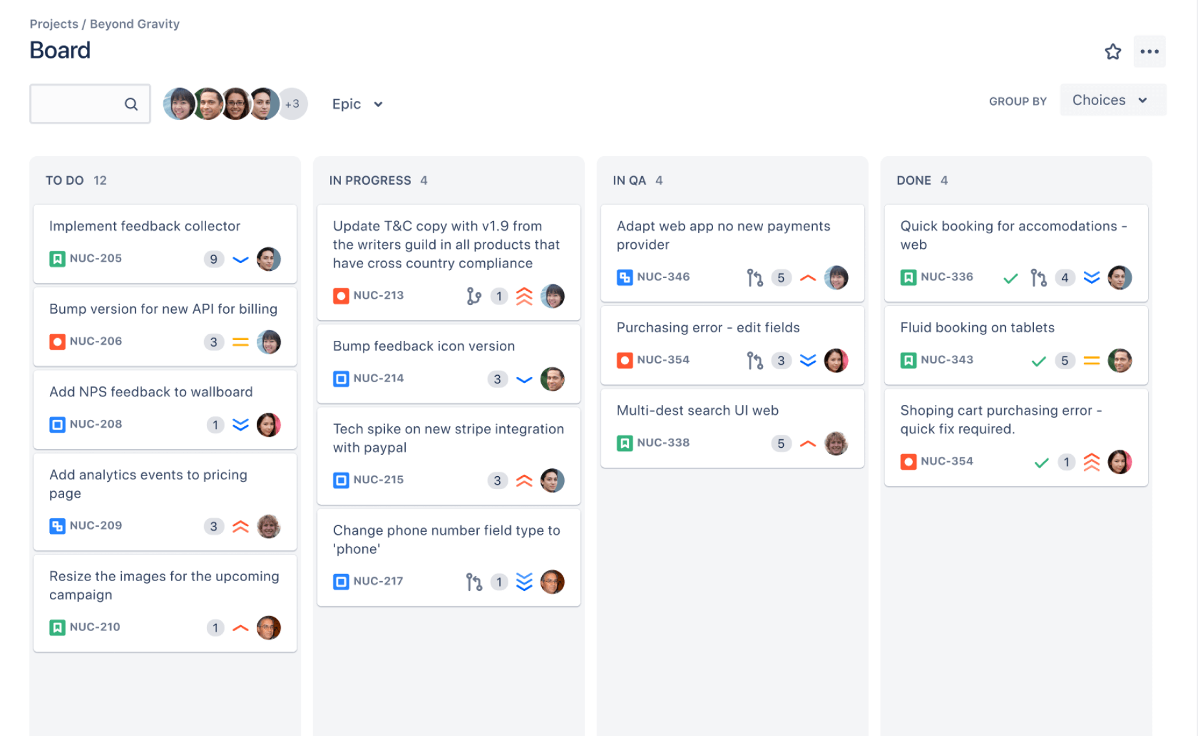
What does a SPRINT BOARD look like in Jira?

Slide 37
What is a USER STORY?
Is a small, self-contained unit of development work designed to accomplish a specific goal within a product (It can represent a user's need, serve as a planning item in agile software development).
We can look at it as a (software) requirement formulated in everyday language so it can be easily understood by everyone who reads it; usually follows the simple format:
E.g: “As a user I want to perform <this action> so that I can accomplish <this goal>.”

Slide 38
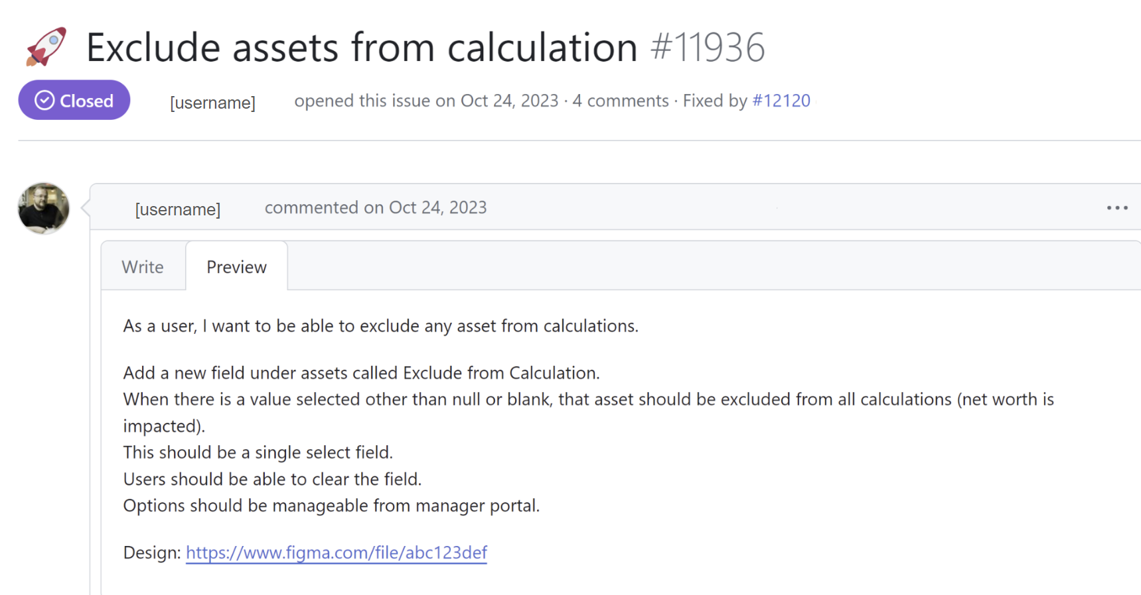
What does a USER STORY look like?

Slide 39
What is a TEST SCENARIO?
What is a TEST CASE?
Test Scenario:
Is a collective set of test cases which helps the testing team to determine the positive and negative characteristics of the project.
Gives a high-level idea of what we need to test.
As a tester, you should put yourself in the end user's shoes and figure out the real-world scenarios and use cases of the applications under test.
Test Case:
Set of actions executed to verify a particular feature or functionality of the software application.
It contains:
Input values
Preconditions
Steps to reproduce
Expected results
Postconditions

Slide 40
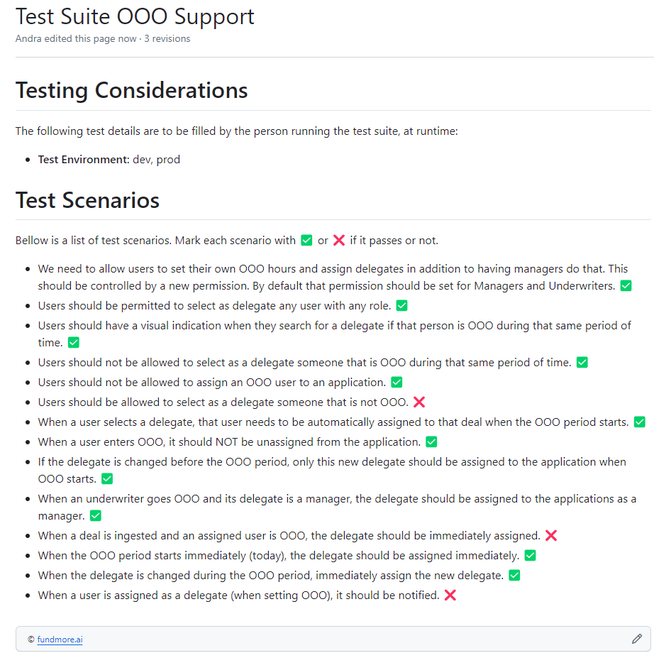
What does a TEST CASE look like?

Slide 41
What is a DEFECT/BUG?
A human being can make an error (mistake) which produces a DEFECT (or a BUG, a flaw) in the code.
If the defect in the code is executed, it can cause a failure, but not all defects result in failures.
In other words, when actual result deviates from the expected result while testing, then it results into a defect. Hence, any deviation from the specification mentioned in the product functional specification document is a defect.
Depending on the organization, the defect is called differently like: bug, issue, incident or problem.

Slide 42
How do we report a Bug?
When reporting a defect a tester should:
Have a clear goal in mind, know exactly what he wants to transmit
Provide developers, managers and others detailed information about the behavior observed and the defect itself
Be precise, concise, clear, unambiguous
Attach screenshots if you can
Express the observations in a neutral tone, fact-focused and impartial
A defect should mainly contain:
Defect ID - Unique identification number for the defect
Title
Severity and priority
Version - Version of the application in which defect was found (optional)
Date Raised - Date when the defect is raised
The name of the person who found the defect
Status of the defect
Description of the defect with:
Steps to reproduce
Expected result
Actual result
Screenshots, logs or videos which capture and prove the defect found
Notes:
Other information that a defect report should contain:
Fixed by - Name/ID of the developer who fixed it
Date Closed - Date when the defect is closed
Severity which describes the impact of the defect on the application
Priority which is related to defect fixing urgency.
(Severity or Priority could be High/Medium/Low based on the impact urgency at which the defect should be fixed respectively.)

Slide 43
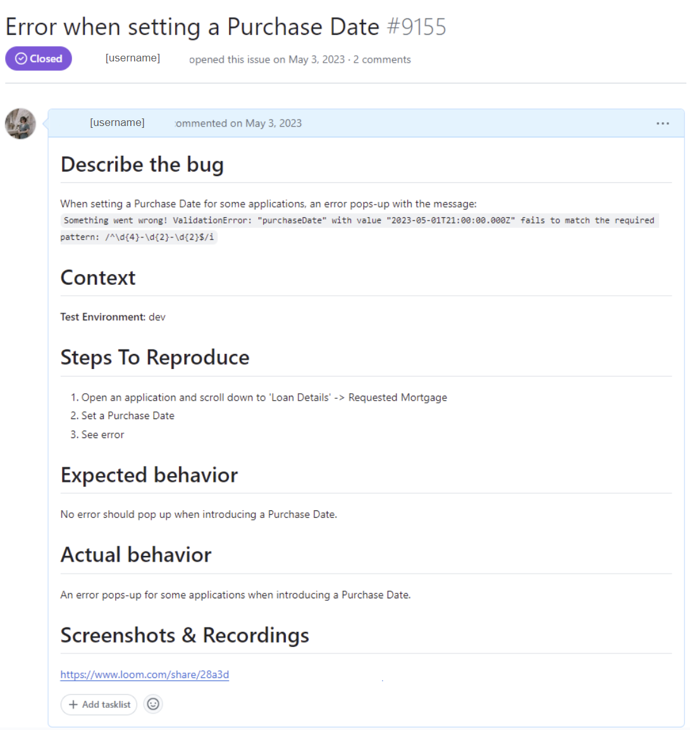
a short description of the bug
where was the bug reproduced
(on what environment)
the steps that need to followed in order to reproduce the issue
what are the expected behavior and the current behavior
link to a video where the bug is reproduced with all necessary steps

Slide 44
Bug Life Cycle example
New
Deferred
Assigned
Rejected
Open
Duplicated
Fixed
Not a Bug
Reopened
Retested
Verified
Closed

Slide 45
Testing & Quality
Testing is part of quality assurance and it contributes to higher quality.
Testing helps in measuring the quality of software in terms of the number of defects found, tests run, test coverage.
Testing identifies defects as early as possible, before the software is in use, in this way avoiding unwanted cost of the stakeholders.
Testing activities and QA activities complete each other:
the goal of a Tester is to find bugs, find them as early as possible and make sure they get fixed.
the goal of a QA person is to create and enforce standards and methods to improve the development process and to prevent bugs from ever occurring.
Testing gives confidence in the quality of the software, because when testing find defects, the quality of the software increases if those defects are fixed.

Slide 46
Directions in testing area
AUTOMATION TESTING

Slide 47
Current situation
CONFERENCES, WORKSHOPS AND EVENTS

Slide 48
Current situation
WFH/WFO,
TEAMS,
TEAM BUILDINGS,
COMPANY EVENTS

Slide 49
Resources & Bibliography
Useful links:
https://artoftesting.com/
https://www.atlassian.com/agile
https://www.softwaretestingtricks.com/
https://www.guru99.com/
http://tryqa.com/
Books:
Foundation of Software Testing – Dorothy Graham
Agile Testing. A Practical Guide For Testers and Agile Teams – Lisa Crispin & Janet Gregory

Slide 50
Thank you!
You can send us questions at:
roxana.soporan@fundmore.ai
andra.banto@fundmore.ai

Slide 51
Quiz time! Let’s play
Access: menti.com
Introduce the code mentioned in the course!
Make sure you fill in your entire name and group number, e.g. RoxanaSoporan_231
01
02
03

